Slide 1

DATA VISUALIZATION

Slide 2
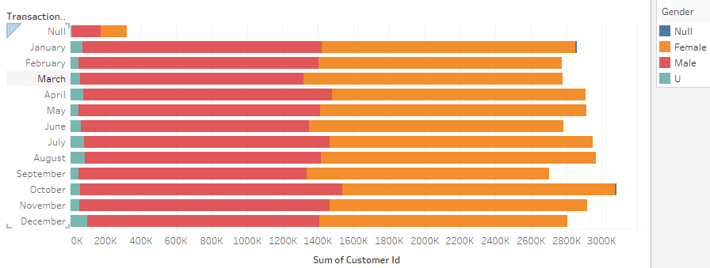
Transaction Month vs Customer ID(gender)

Slide 3
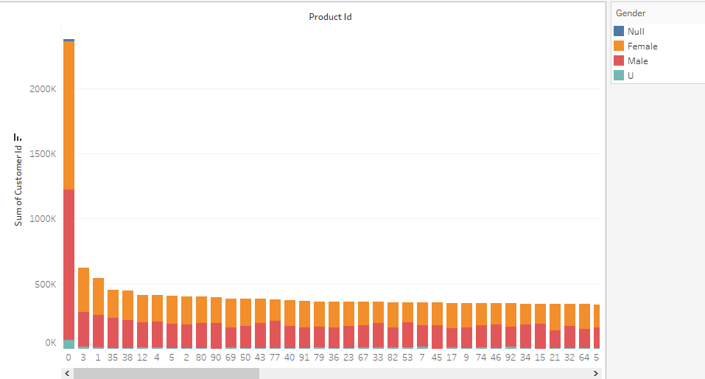
Product ID vs Customer ID(gender)

Slide 4
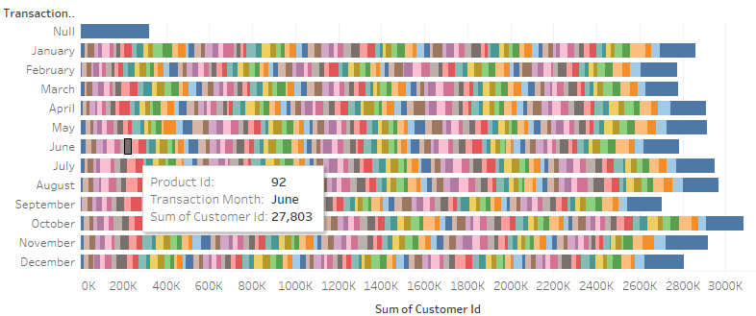
Transaction ID vs CustomerID & ProductID

